Slide 1

EHC Hub
Customer Forum
Jamie Rowell, Product Manager
23 November 2022
Notes:
Welcome.
Recorded session?
Share contact details with all attendees?

Slide 2
Agenda
10:30 – 10:45am | Introduction
10:45 – 11:15am | Headlines from 2022 and the proposed roadmap for 2023
11:15am – 12:00pm | Parent/carer feedback and accessing the EHC Hub using a mobile phone
12:00 – 12:45pm | Lunch break
12:45 – 1:05pm | Discussion: How much of a need is there for the Hub to manage re-assessments?
1:05 – 1:25pm | Discussion: When an LA is delayed in their review decision, would allowing a SENCo to begin the next review in the Hub help or hinder the situation?
1:25 – 1:45pm | Improvements to the Plan stage: Making it easier to write an EHC Plan online
1:45 – 2:05pm | Customer priorities
2:05 – 2:30pm | Q & A
2:30pm | Finish

Slide 3
Headlines from 2022
Updates to the EHC Hub during 2022 have introduced some key features and improvements.
  Panel meetings
    Manage panel meetings
    Create agenda
    Send invitations
    Proportional access
  Help page
    Targeted guidance documents and videos for every user
  SEN2 export
    New areas to record information required for the SEN2 return
    A new data export to support the SEN2 return
  Parent comments
    More space for parents and carers to comment on a draft EHC Plan
  Extra admin control
    Change the issue date of an EHC Plan (with audit)
Notes:
Using the Hub to arrange and manage decision panel meetings has saved a considerable amount of time for SEN teams.
A dedicated page to turn to for help and guidance has been long overdue and well received. The content of those pages can be tailored to groups of users and can be kept up to date, including with contact details, by Hub administrators.
The Hub now has a space to record all of the data items necessary for the personal level SEN2 return to the DfE. Coordinator managers have access to download a data export designed to support the return.
Parents have more space to add and read their comments on a draft EHC Plan, addressing direct feedback received during the spring.
A new admin control enables the issue date of an EHC Plan to be updated where the displayed date is inaccurate, e.g. a mistake when importing a plan. Changing the date includes a full audit on the case timeline. This can be really useful to help address operational backlogs.

Slide 4

Proposed roadmap for 2023
Customer consultations
Mobile view
EHC Plan
Auto save
Simplifying education setting roles
Sharing proposed amendments with a decision to amend (Judicial Review -- case No: CO13072020)
Information clearer and more accessible on a mobile phone
Simpler account registration
More context for parents/carers
Updated Hub design
Improving the way that an EHC Plan is written online
Making it simpler and clearer for parents and carers to add their comments
Automatically save changes
Notes:
4 updates to the EHC Hub are planned in 2023. These are aimed at delivering 2 key customer consultations from this year, using the Hub on a mobile phone, writing and commenting on an EHC Plan and implementing an auto save feature.
Update 1
Simplifying the education setting roles follows a consultation piece from earlier in the year where the current SENCo, Headteacher and Chair of Governor roles are simplified to a setting user and setting administrator.
A change to the order of notifications at the end of a review when the decision is to amend the EHC Plan will allow a proposed amendment to be prepared and shared at the same time as the decision to amend is published. This is designed to meet the clarification delivered as part of a judicial review earlier this year.
Update 2
The second update will deliver improvements to how the Hub works on small devices (i.e. mobile phones). Specifically making information clearer and have greater context for parents when they log in. Also included is clearer account registration and an updated look and feel. Example designs are coming up today.
Update 3
Changes to improve the act of writing an EHC Plan online to help deal with the volume of information available versus the amount of space that a screen offers. This extends to parents commenting on a draft as well. Example designs are coming up today.
Update 4
Possibly the number one requested feature by users of the Hub that we have spoken to and particularly from parents and SENCos. Having the Hub auto save changes periodically. There is some finer detail still to be worked out over the period (e.g. key strokes or time) and which areas of the Hub it would most benefit and if that can be delivered across the Hub or as a phased approach.

Slide 5

Parent/carer feedback

Slide 6
Listening to parents and carers
One of our biggest areas of focus in 2023 is making the Hub work better for parents. We plan to do that by listening to the challenges that they face right now.
Review older feedback
Meet with parent and carer groups
Publish a questionnaire
Notes:
3 part approach
Review feedback we’ve previously recorded (some of that indirectly passed to us by local authorities and SENCos) and start planning early. We’ll see those plans shortly.
Meet with parent and carer groups, give them a forum to talk about their challenges and listen. Several local authorities have already taken up our offer in September and October to meet with groups in November.
North Lincs
North East Lincs
Hampshire
Southend
Planned sessions with Devon and Nottinghamshire still to come this month
Published a questionnaire and shared access to it with all local authorities to reach as many parents and carers as possible that we have not been able to meet. That will run until the end of the month, at which point we’ll close the survey and share the results with local authorities before Christmas.
The intention of all of this feedback is to validate the changes that we have in mind, keep us focused on the changes that will have the most impact and inform the finer detail of the required improvements.

Slide 7
Early numbers from the questionnaire
Number of responses
Use a mobile phone
Use the Hub for
reviews
140
44%
79%
Have a positive or
neutral experience
Have a negative
experience
Don’t know from
where to get help
56%
44%
67%

Slide 8
Overview of feedback so far
Needs improvement
Works well
Difficult to access information on a mobile phone
Registering my account was hard
    Test message option not clear
    Wasted time with expired registration emails
Emails don’t include enough detail
I lost changes when I got a call – Auto save, please!
Only one comment box for Section A
Navigating between sections is difficult to comprehend
I thought submit was save
Not intuitive
Information is often out of date
I can download the plan, everything else is overwhelming!
Process moved quicker with the Hub than before the Hub was around
I’ve heard good feedback from another parent
It worked well with the school
Kudos for the security of the Hub
Intuitive
Loves using the Hub … on a laptop
Not had any problems and is easy to use
Notes:
Key takeaway for us is this response to the questionnaire:
How would you rate your overall experience of using the EHC Hub so far?
“Positive on a laptop but very poor on a mobile device. I worry this would really impact the use of EHC Hub for people that do not have a laptop of desktop.”

Slide 9
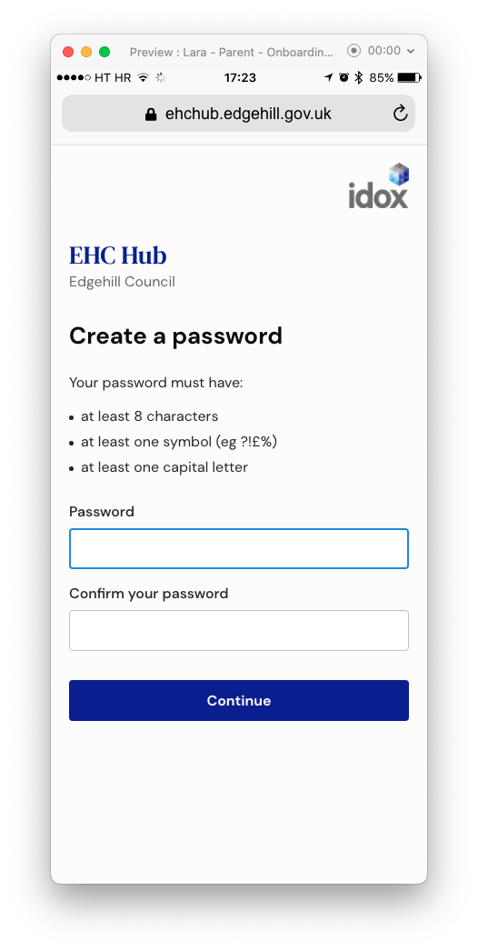
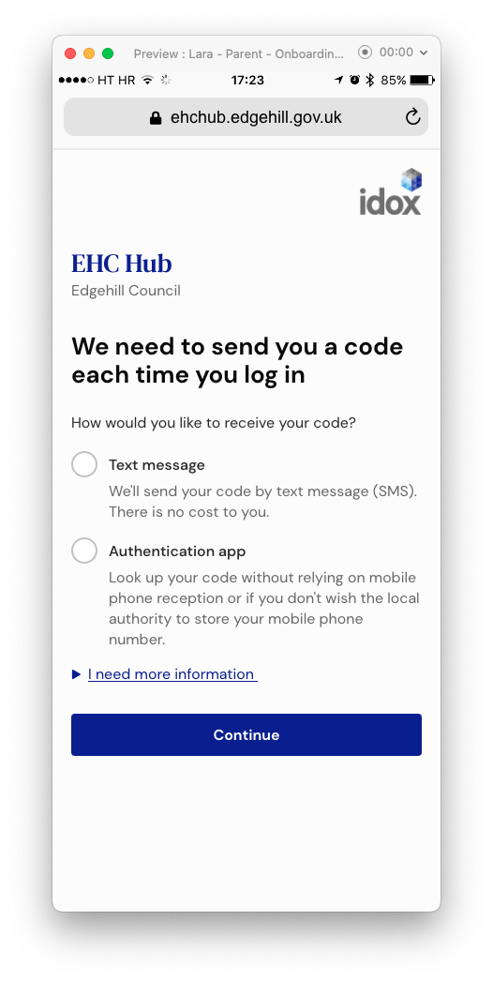
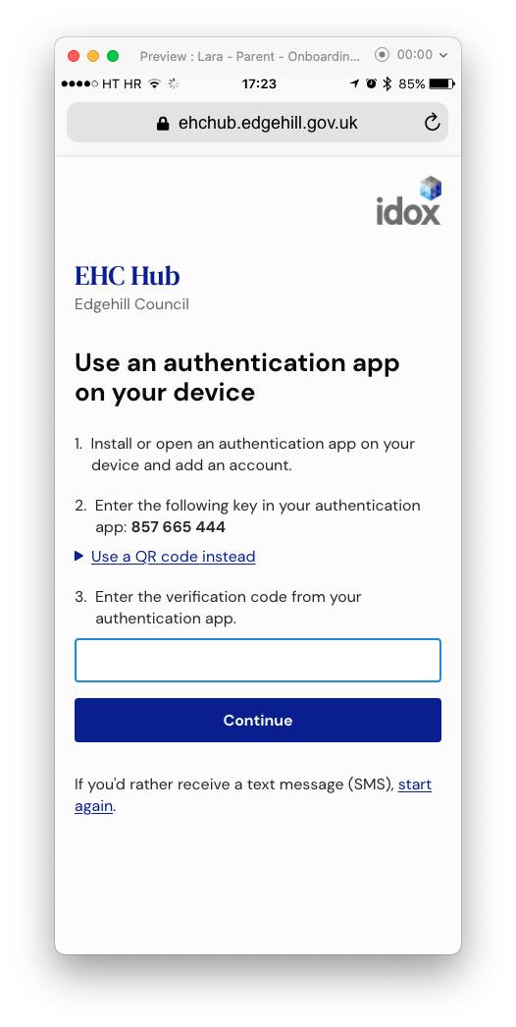
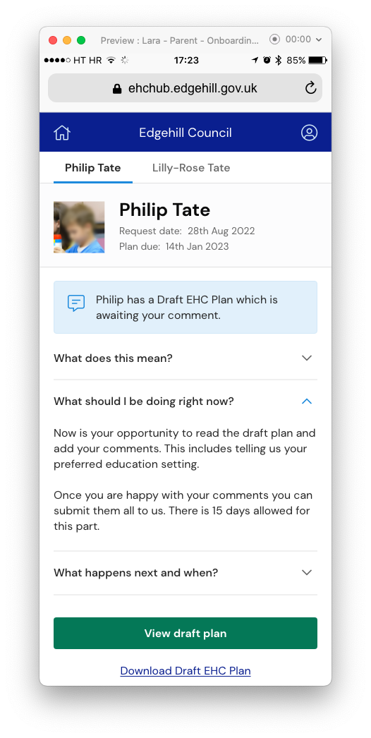
Accessing the Hub on a mobile phone
Registering your account and greater context for parents and carers.
Notes:
Accessing the hub on a mobile phone. We want to guide people through the process with clear instruction.
Creating a password is informed.
Removing jargon such as two factor authentication and using plain English to explain what’s needed and what to expect. Not giving more weight to one option or the other and explaining the benefit of each.
Considering the device that the person is using; e.g. when choosing to receive the code via an app on a smartphone, hiding the QR code in this type of view.
Parents get immediate information on what is happening now, what they are being asked do, what that means and what’s happing next and when – as soon as they log in.

Slide 10
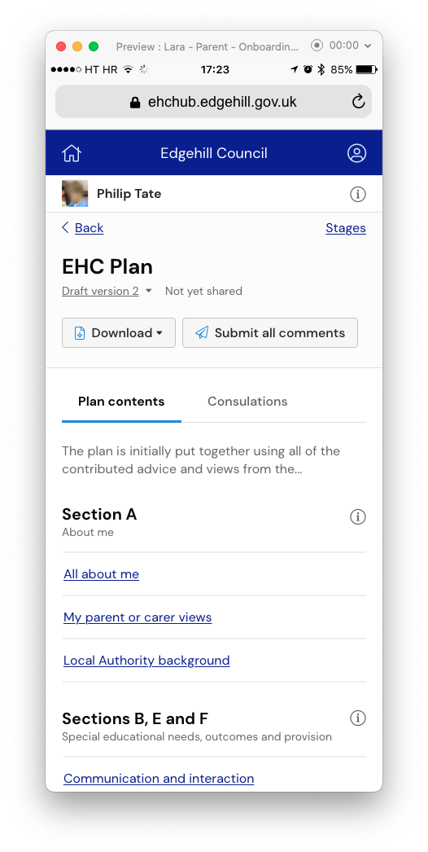
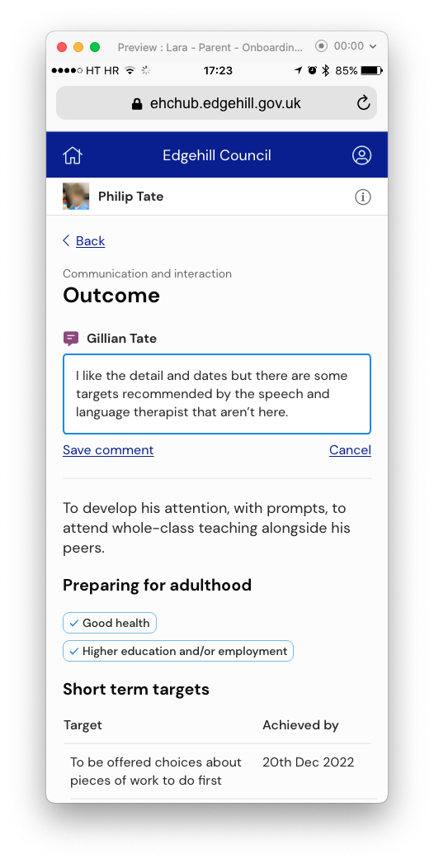
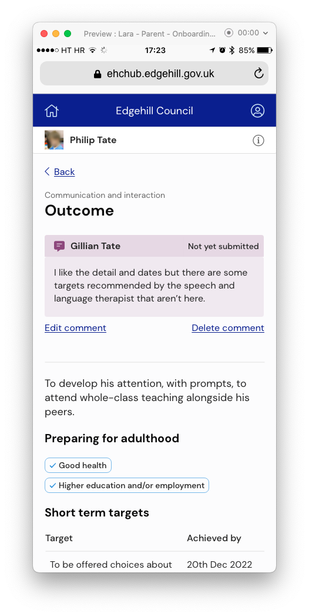
Accessing the Hub on a mobile phone
Commenting on a draft EHC Plan should not be restricted by a particular device.
Notes:
Continuing those ideas forward to then a parent commenting on a draft EHC Plan.
Viewing the draft plan takes us in to a task list style of sections which is intended to be easier to take in.
Opening a section to comment on is more bite-sized.
Saved comments stand out more and can continue to be edited or deleted before choosing to submit all of the comments as they would do now. There’s also a reminder to show whether this has been submitted or not.

Slide 11
Lunch
12:00 – 12:45pm

Slide 12
Discussion
How much of a need is there for the Hub to manage re-assessments?
  The working group
    A working group of customer local authorities met on 2nd March to discuss the requirement to manage re-assessments in the EHC Hub.
    The main points of consideration were:
    A re-assessment should be possible at any time
    Often there are no re-assessments carried out in a calendar year
    A separate pathway to manage re-assessments is unnecessary
    A decision to re-assess should not be recorded on the EHC Hub

Slide 13
Discussion
When a local authority is delayed in their review decision, would allowing a SENCo to begin the next review in the Hub help or hinder the situation?
  Intention vs Reality
    The EHC Hub supports a process whereby the review of an EHC Plan can begin in time to be completed by the anniversary of the last one.
    The Hub is not expecting the previous review to still be “in progress” due to delays in publishing a decision on the outcome of the review or in amending a plan. This means a new review cannot be started in the Hub by the setting.
    What challenges does this create for the child/young person, their family, the setting and the local authority?
    What issues would be created by allowing more than one review at a time?
    Is a ‘backlog of reviews’ more difficult to resolve by forcing SENCos to hold reviews away from the Hub?

Slide 14
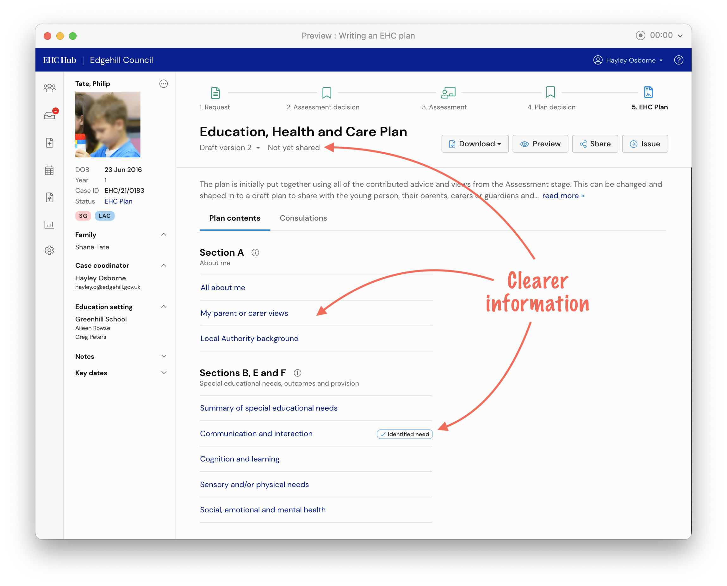
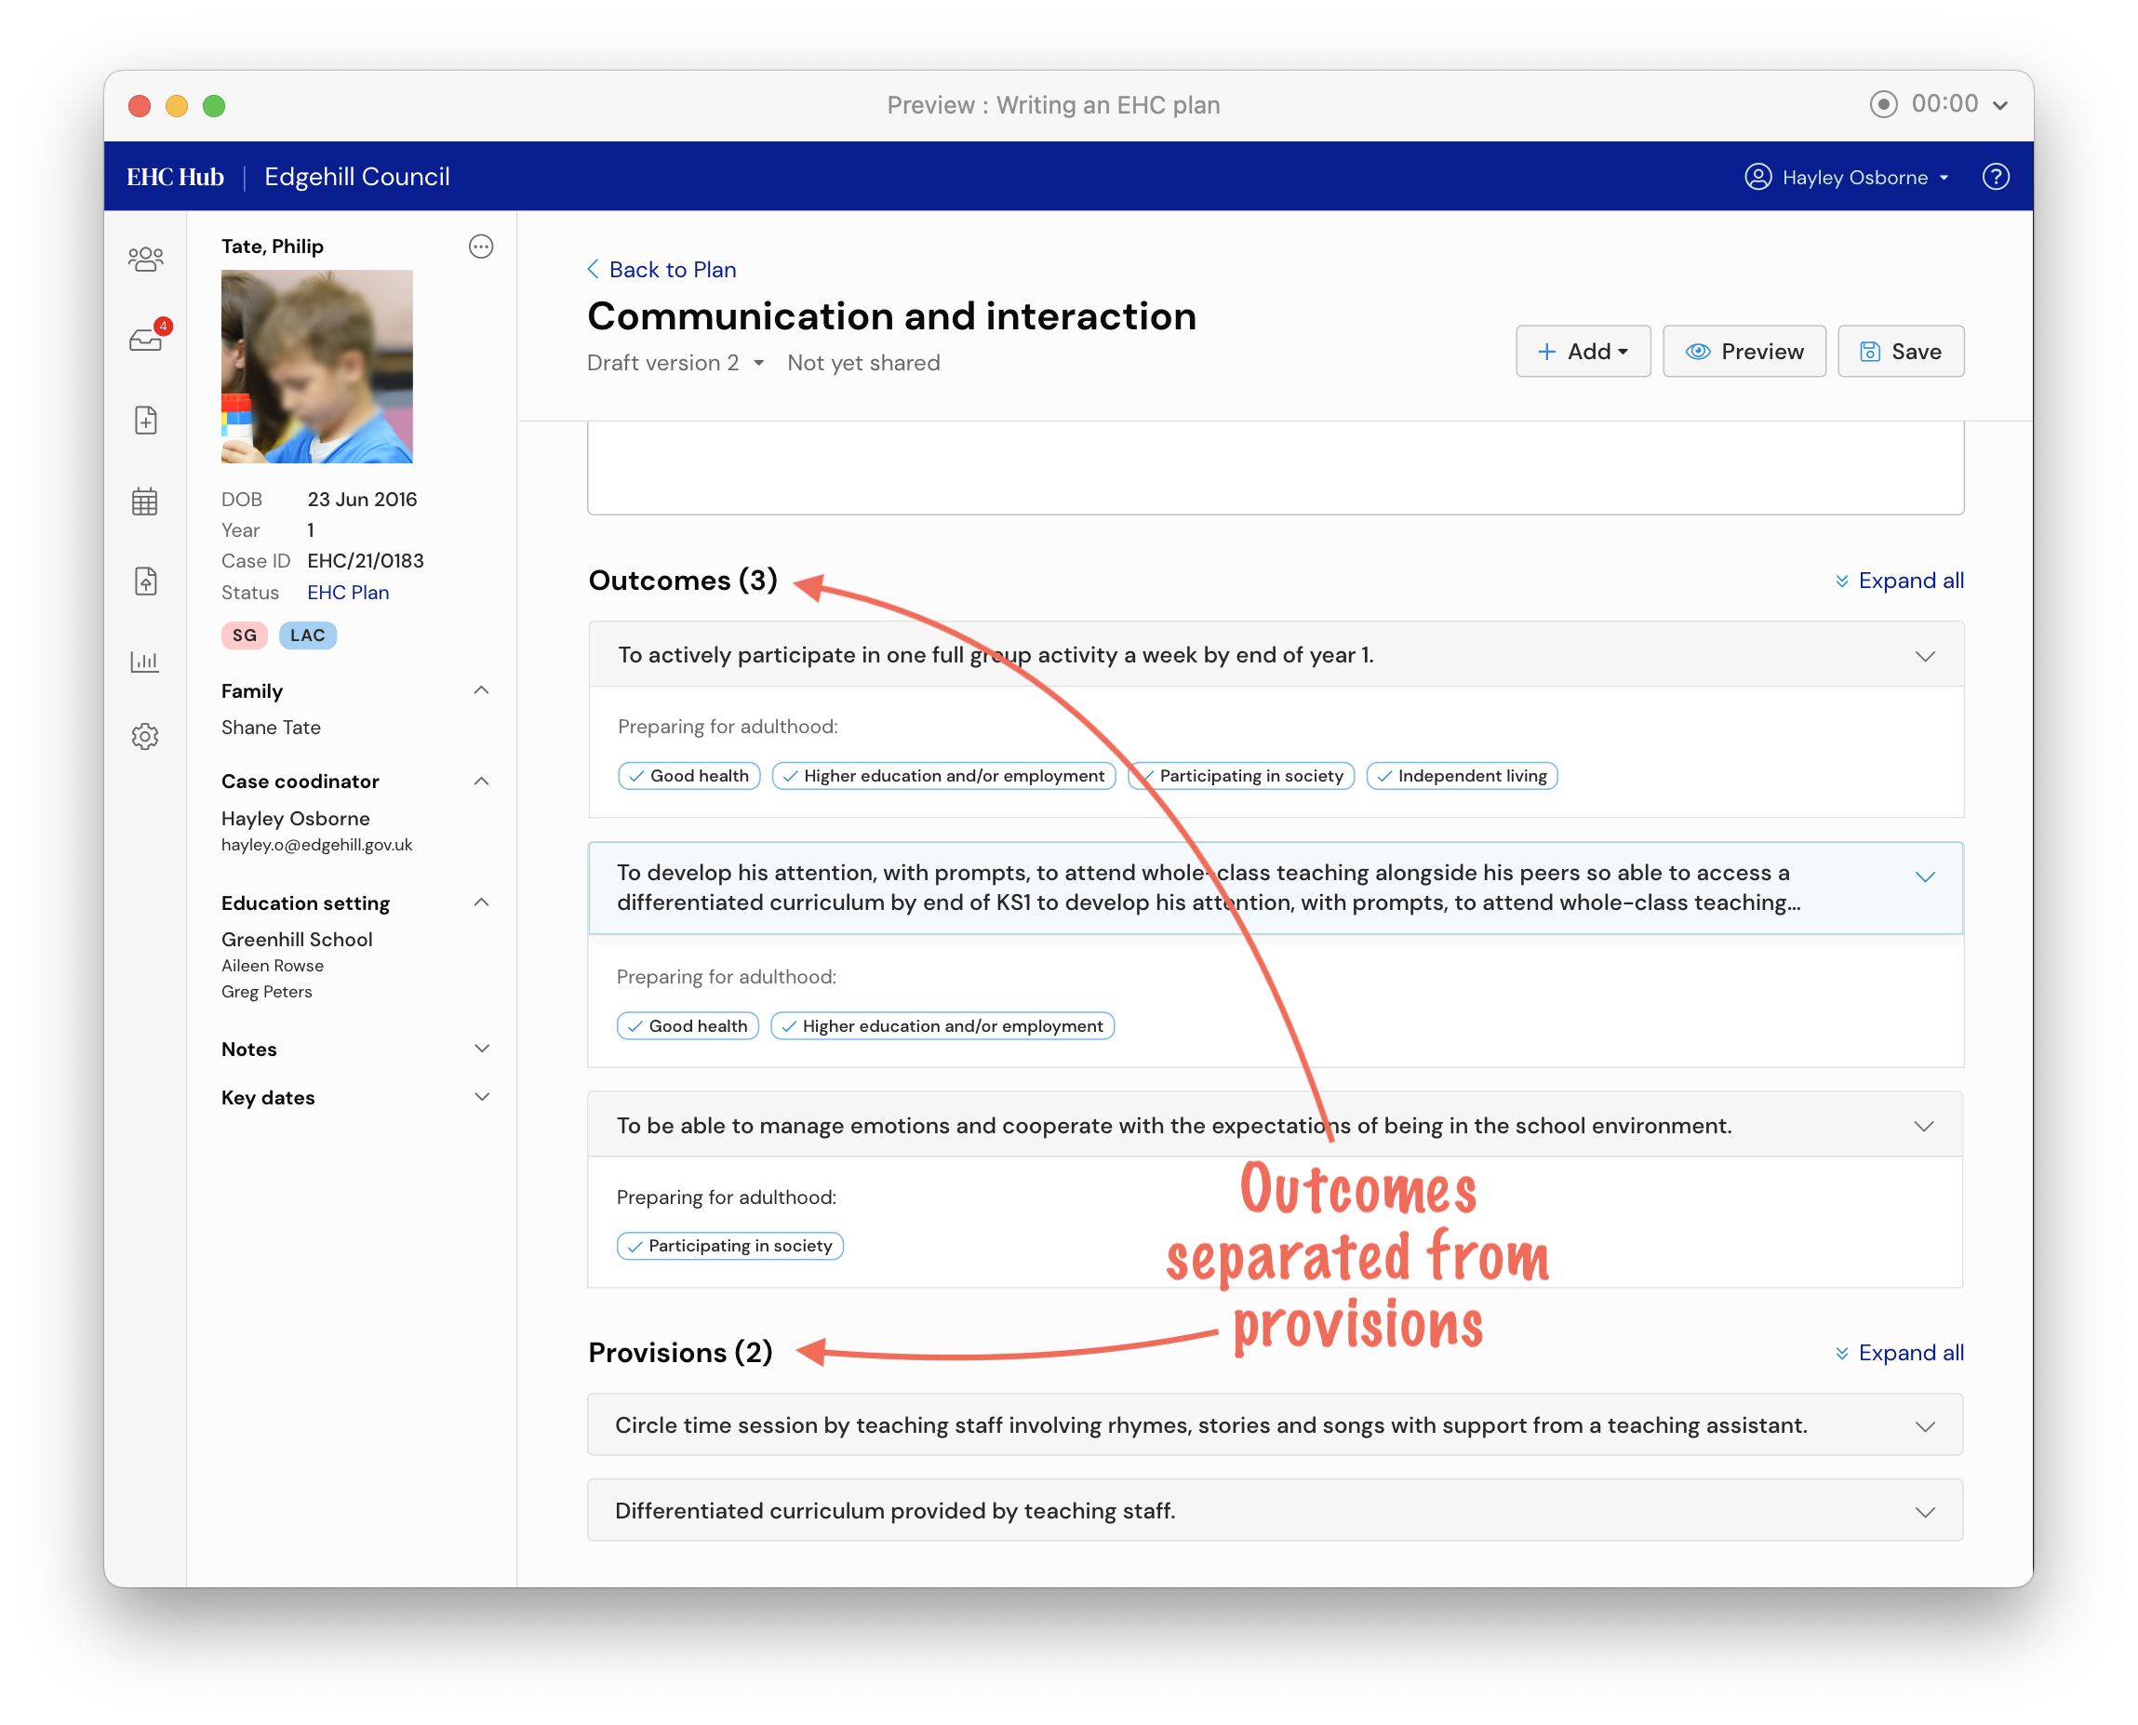
Improvements to the Plan stage
Making it easier to write an EHC Plan online.
Notes:
Improvements to the plan stage aimed at making it easier to write a plan online. Compliments the designs earlier showing parent commenting and on a mobile device.
The plan stage takes a lead from the GDS (Government Design System) to utilise a task list style for the sections of the plan.
Space is created to allow information on the page to be clearer.
The four primary areas of SEN are separated rather than grouped.
Within a section, the top of the screen offers greater context to where we are within the plan and how to go back a step.
Needs is moved above strengths (slightly out of the shown design) and importantly, provisions are separated from outcomes.

Slide 15

Customer priorities
Which improvements to the EHC Hub would make a difference in your local authority?
Notes:
Of all the improvements to the Hub, many discussed today and some that may not have been, which changes are most important to your local authority?
Greater administration controls? E.g. roll back cases
Improved timeline?
One work tray or split work trays?
Combining the current and previous school history?

Slide 16

Q & A

Slide 17
Thank you.
Further questions to jamie.rowell@idoxgroup.com

