Slide 1
Education, Health & Care Plans (EHCP)
The EHC Hub
Parent Support Information
Contact: ServiceOrganiser.AnnualReview@nottscc.gov.uk

Slide 2




Why Are We Going Digital?
Going Digital
SEND Review
Joint Working
Increase
Transparency
The Government SEND Review recognises the need for a secure central location for EHCP’s
With access to all the relevant information for producing, maintaining and reviewing the plan
In a streamlined way that is easy to navigate and access
Nottinghamshire Local Authority are committed to supporting the engagement, contributions, and collaboration of assessments and reviews
Having a shared platform enables joint working
Investing in a digital platform enables an easy way to share information with the intent to create clarity, trust and accountability
When actions are completed everyone is informed at the same time

Slide 3


SEND Review Section 20-23 - We propose to digitize EHCPs to reduce bureaucracy, recognising the need for a secure central location for parents, carers and professionals to upload key information. To make sure they can access all the relevant information for producing, maintaining and reviewing the plan in a streamlined way that is easy to navigate and access.
Nottinghamshire Local Authority recognise the need for digitalisation and have invested in an online digital platform, The EHC Hub, from the company Idox .
The EHC Hub is an innovative digital platform supporting engagement, contributions and collaboration on EHC assessments, plans and reviews. It offers complete transparency for families, professionals and education settings, truly transforming the way Local Authorities work with their partners.
The SEND Review & The EHC Hub
Benefit: Parents and carers can request a needs assessment on behalf of their child, track the progress of their case and contribute their views. They can also contribute the views of their child or young person and read the other contributions made by educations settings, health and social care professionals.95% of EHCP Assessment requests are made digitally via the EHC Hub

Slide 4

EHC Hub- Introduction for parents and carers

Slide 5
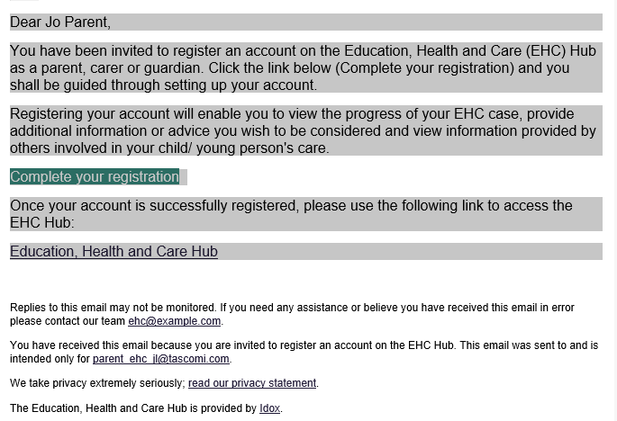
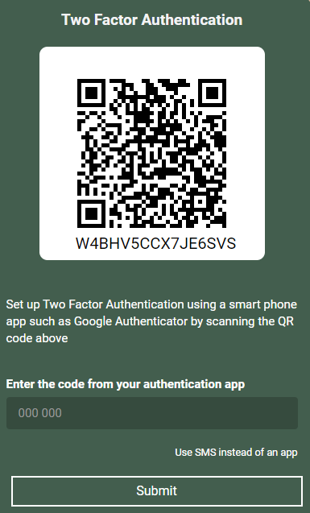

Using the EHC Hub-Logging In
In order to access the Hub, you will need a username and password.
There is also a second level of security (known
as two factor authentication) which will involve
entering a six-digit code provided to you by either an authentication app or a text message.
When you are added to the EHC Hub, you will receive a registration email
Your username is your email address
You choose your own password
Pick how you want to receive the 6-digit code
Click Submit
Your registration email will look like this:
Click- complete your registration
and choose a password
Once your username and password have
been entered correctly, the following
page will be displayed:
This is a second level of security, we
suggest using the SMS (text) option
by clicking here
If you have any problems, please do contact:
ServiceOrganiser.AnnualReview@nottscc.gov.uk

Slide 6
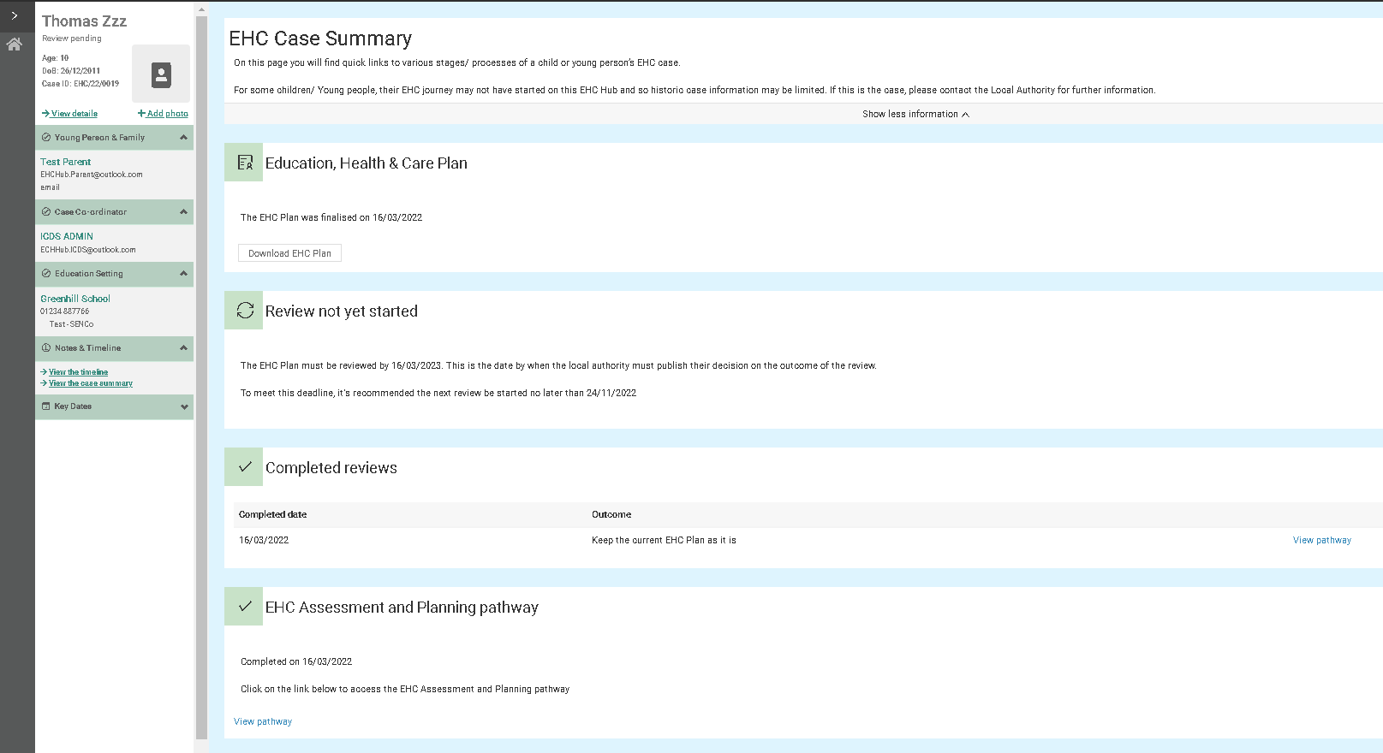

Using the EHC Hub-Summary Screen
You can download the EHCP here
The information about when a review is due can be found here
All previous assessments and reviews (including any letters relating to them) can be viewed by clicking:
‘view pathway’
We recommend you view the EHC Hub on a PC or Laptop however, there is a new development
coming soon that will make it much easier to view
on a mobile device.
General information is here, including who the allocated case coordinator is and their contact details

Slide 7

The EHC Hub- Support
ICDS Duty
Service Organiser
Educational Setting
Ask Us
Free, confidential Information, Advice and Support Service for CYP/Parent/Carers
Bassetlaw and Newark & Sherwood areas: icdsehcBandNSlocality@nottscc.gov.uk
One stop shop for all things EHC Hub & Annual Review
Support and training is available for all educational settings from the Service
Case Coordinator
Mansfield and Ashfield areas: icdsehcMandAlocality@nottscc.gov.uk
Broxtowe, Gedling and Rushcliffe areas: icdsehcBGRlocality@nottscc.gov.uk
Organiser and Idox if required, to enable settings to support CYP/Parent Carers
This includes training, videos, FAQ’s, user guides, presentations and more
Every CYP in Nottinghamshire is allocated an ICDS Case Worker, this can be seen in the EHC Hub on the left-hand side panel
The ICDS Duty contact can also provide the details of the coordinator
ServiceOrganiser.AnnualReview@nottscc.gov.uk
Web: www.askusnotts.org.uk
The Service Organiser can help with logging in/password issues and general use
Tel: 0800 121 7772
Post-16 Team: icdsehcpost16@nottscc.gov.uk

Slide 8

We would really love all children, young people and their families to engage with the EHC Hub however, this will always be your choice.
Should you have any questions at all please don’t hesitate to contact the Service Organiser.
Q. Do I have to use the EHC Hub?
A. Not if you do not wish to. Your views, contributions and all other available information and details of progress can be provided with the assistance of the SENCo in your child’s education setting or the Case Coordinator within the Local Authority.
Q. Is the EHC Hub secure and who can see my child’s details?
A. The hub is secured by two factor authentication and offers the same level of protection as would be expected of online banking services. Access to any child or young person’s details is by invitation only and controlled by the Local Authority. When viewing your child’s information, you can see the names of all other parties that have been invited to view or contribute towards the case.
Q. Will I receive updates on my child’s case?
A. Yes, you will receive an email whenever a stage is complete, or you’re requested to provide information or views.
Q. How do I know what should be happening next and by when?
A. Next steps and key dates are clearly displayed in the hub at all stages of the process.
Q. If my child already has a plan, can we use the EHC Hub?
A. Yes. Your child’s plan will be reviewed using the hub so you can contribute and track progress.
Q. What happens if I forget my password?
A. There is a link on the hub’s homepage to securely reset your password at any time.
FAQs

